Slide 1


EnnoShoes
Platform dedicated to the online sale of sneakers.
ADMINS:
VINCENZO MORGESE: 0124003094;
PASQUALE FIORE:0124003095.

Slide 2
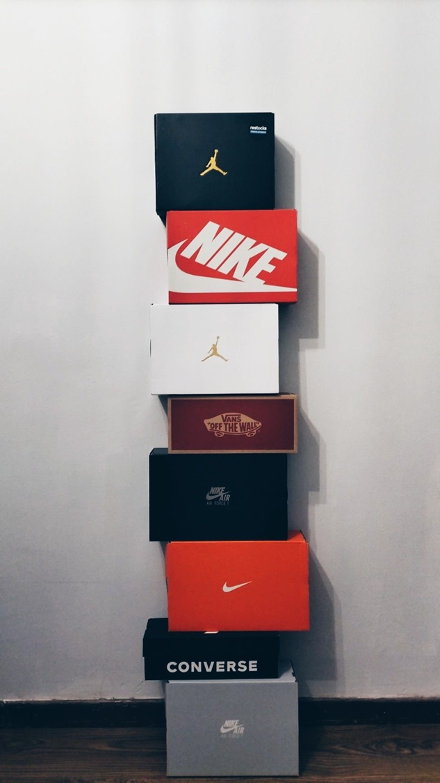
Service
The website offers a clear and intuitive product showcase, allowing users to easily and quickly browse the entire sneakers catalog. In addition, the purchasing process is supported by a fast payment system. Finally, the site allows users to register in order to have their own personal reserved area.

Slide 3

GOALS
Shoe catalog management;
User management;
Order and payment management.
Morgese Vincenzo
Fiore Pasquale

Slide 4
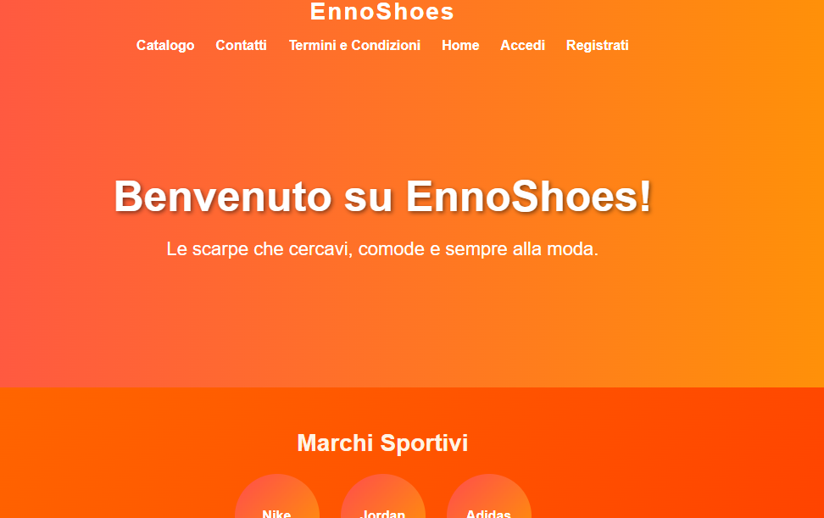
HOME
WELCOME TO THE ENNOSHOES HOME PAGE!
THE HOME PAGE ALLOWS YOU TO BROWSE THE WEBSITE AND ACCESS OUR AMAZING CATALOGS!

Slide 5
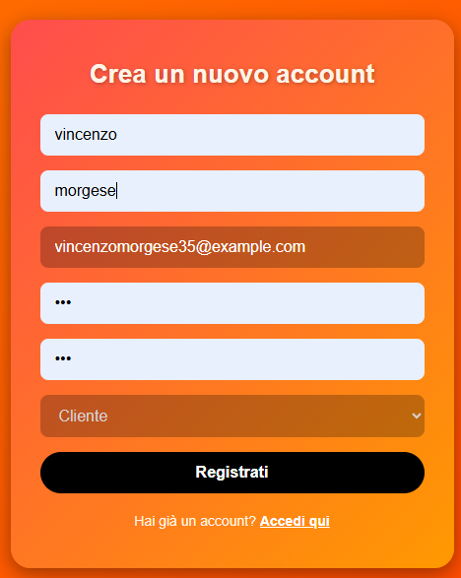
REGISTRATION
CREATE YOUR ACCOUNT BY PROVIDING YOUR PERSONAL INFORMATION, AS WELL AS YOUR EMAIL AND THE ROLE YOU WILL HAVE ON THE SITE.

Slide 6
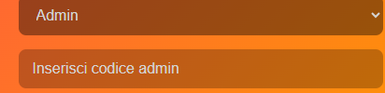
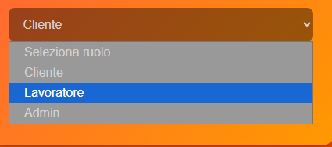
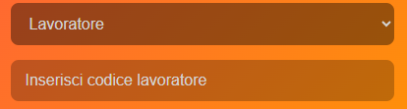
USER ROLE
IF YOU ARE NOT A REGULAR CUSTOMER BUT AN EMPLOYEE OR EVEN ONE OF THE TWO ADMINS, YOU MUST ENTER THE CODE.
IF YOU ARE AN EMPLOYEE, THE CODE WILL BE PROVIDED TO YOU BY THE ADMIN

Slide 7
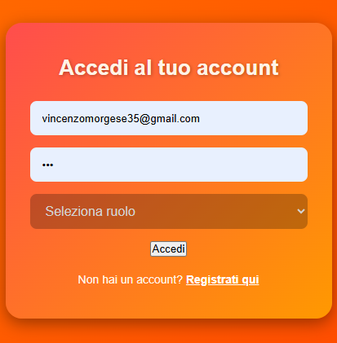
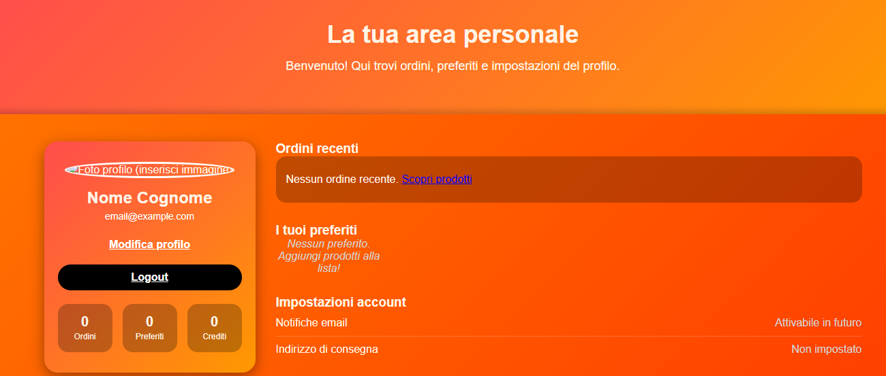
LOGIN/DASHBOARD
After logging in, the registered user will have access to their personal area.

Slide 8
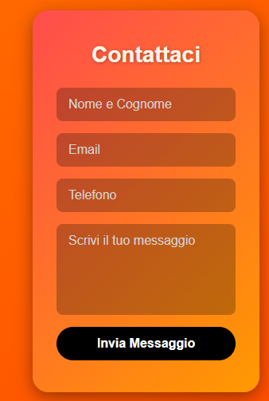
CONTACT US
IF YOU NEED INFORMATION OR ASSISTANCE, CONTACT US.

Slide 9
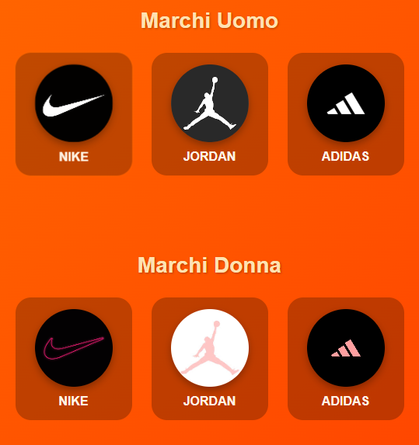
CATALOG
CHOOSE YOUR PREFERRED BRAND AND PURCHASE THE SHOES YOU LIKE THE MOST THROUGH OUR CATALOGS.

Slide 10
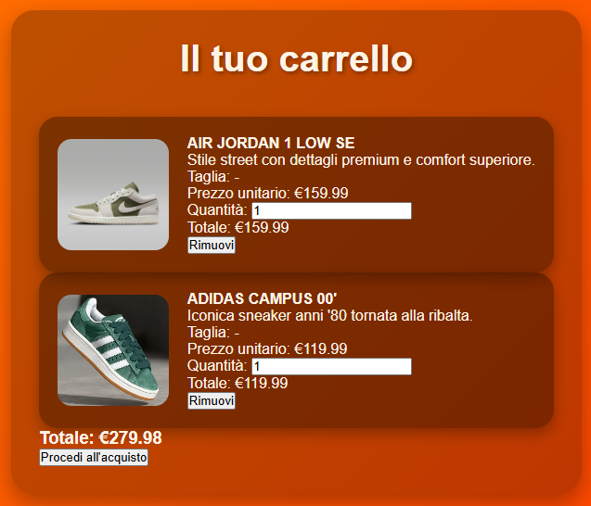
CART
ADD PRODUCTS TO YOUR CART AND WHEN YOU ARE READY, PROCEED TO CHECKOUT.

